Slide 1
Exam 2 Database
MentorShip

Slide 2
1. Topic 2. Database 3. Power Bi

Slide 3
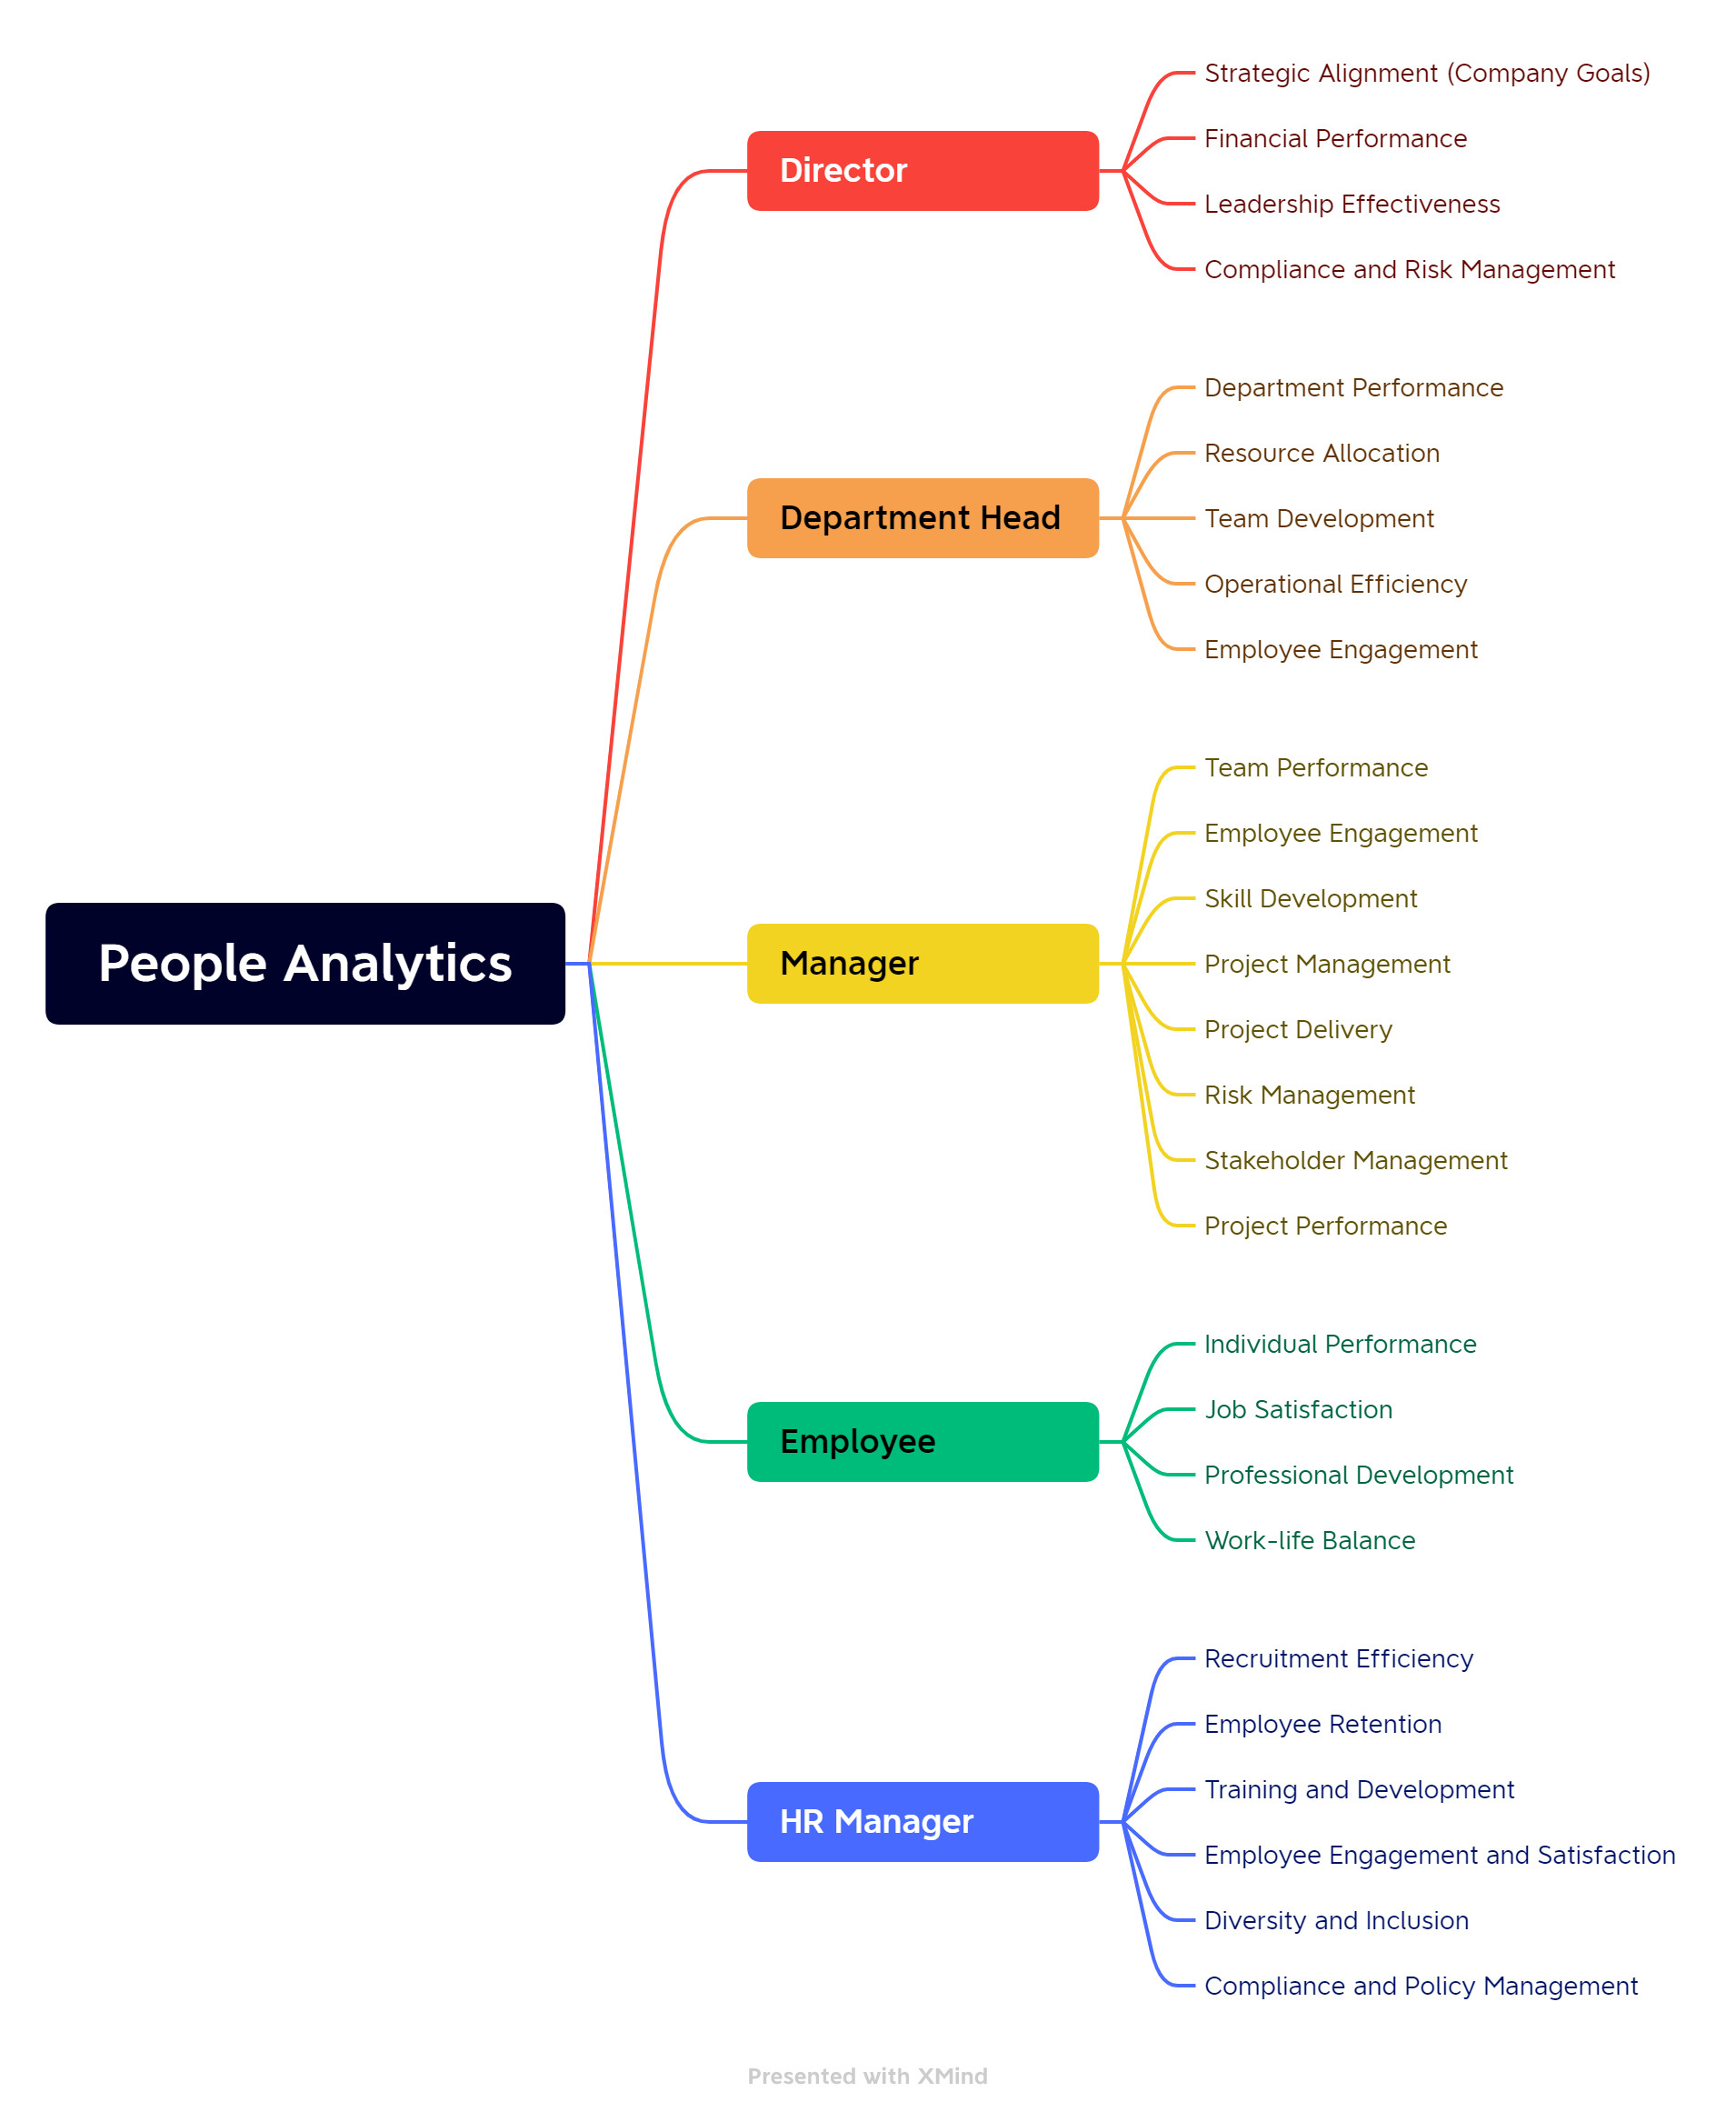
1. Topic
Role:
Director
Department Head
Department Head
Department Head
HR Manager
=> Design 5 Layout

Slide 4
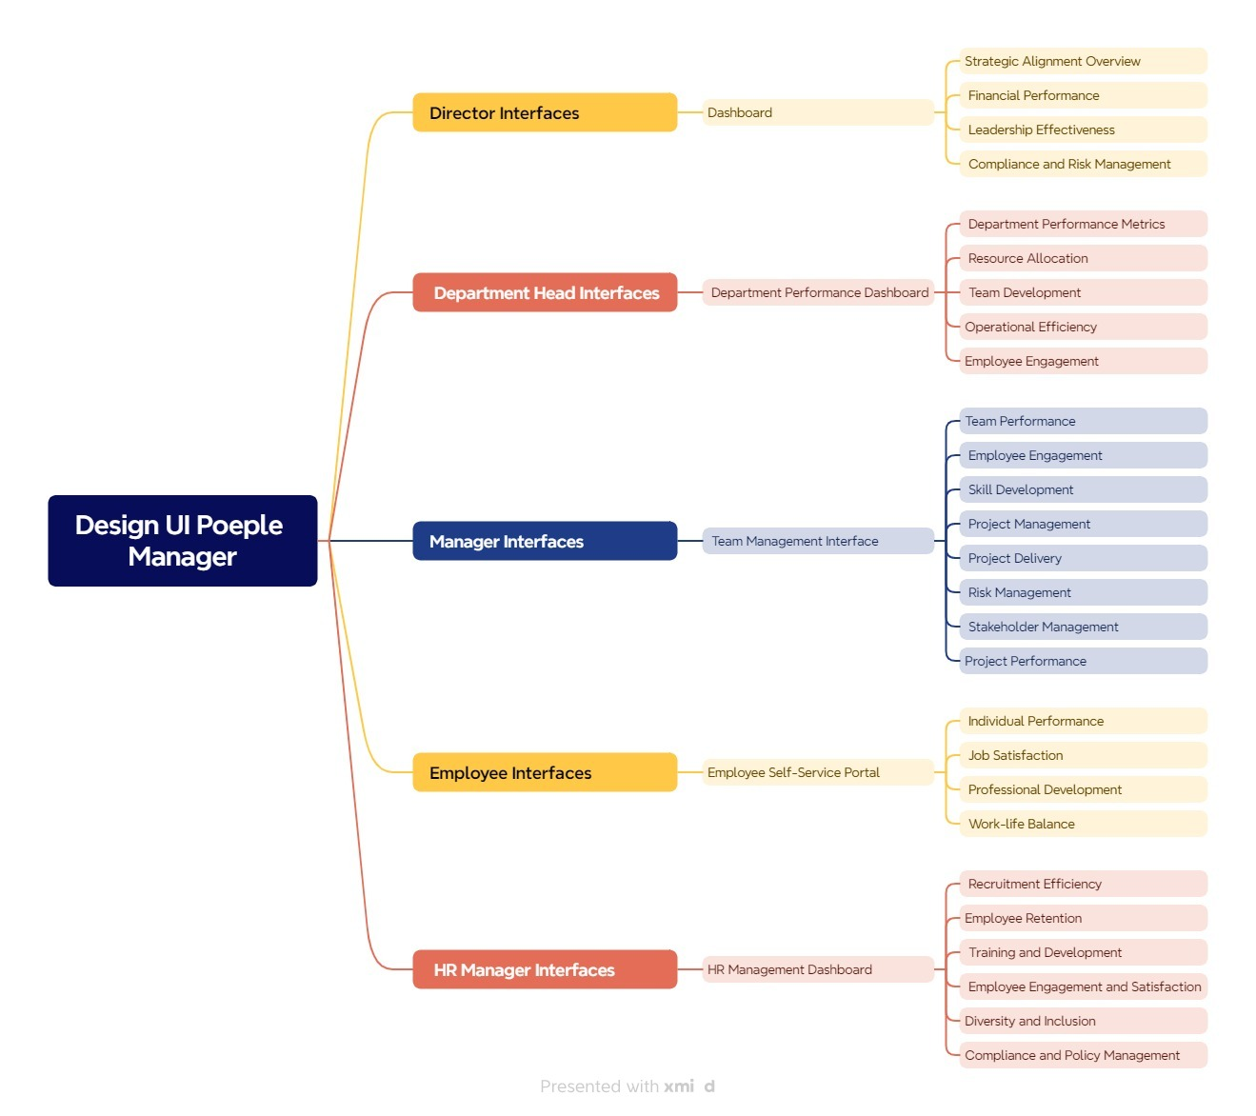

Slide 5
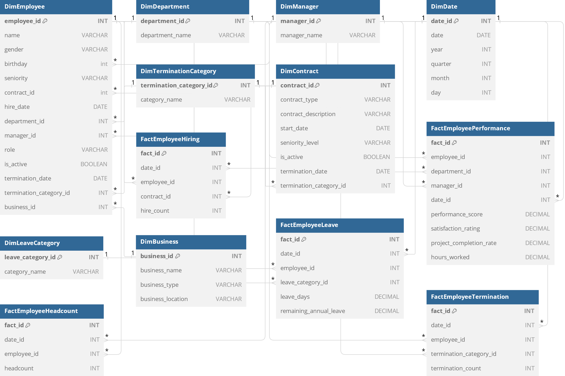
2.Database

